Slide 1
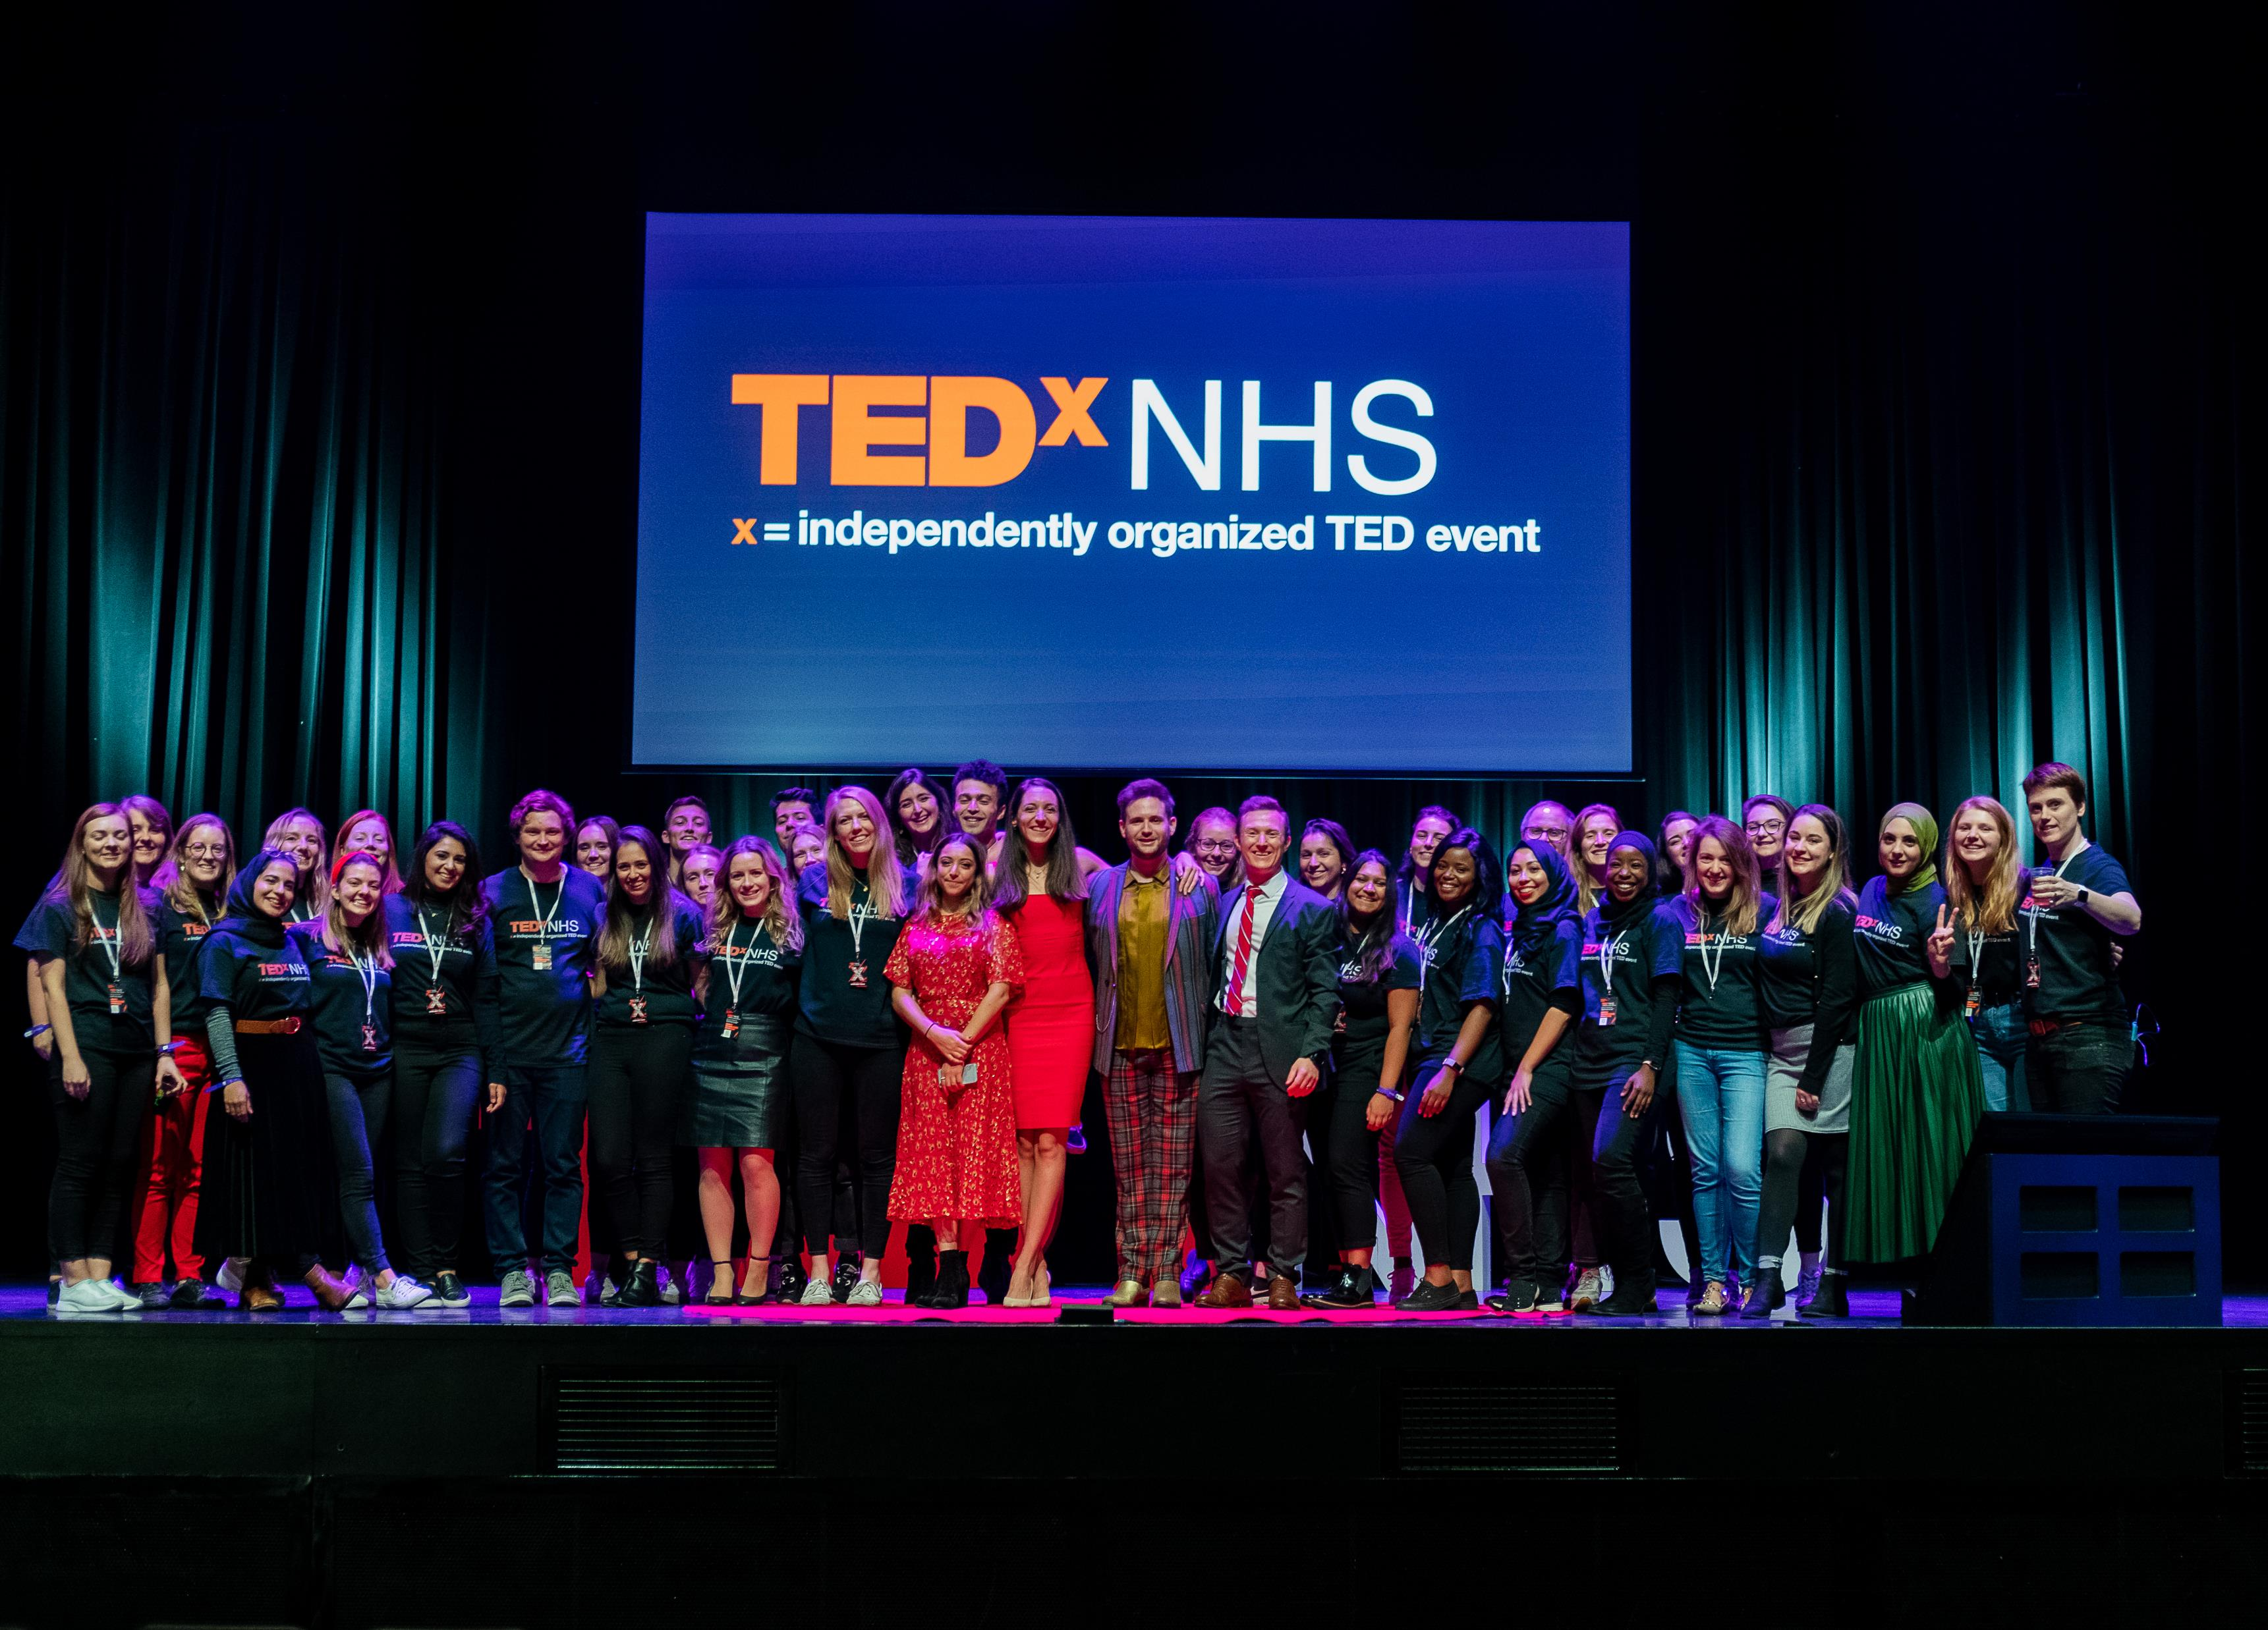
Introduction

Slide 2
TED is a global community that brings together the world's leading thinkers and doers to share ideas that matter in any discipline — technology, entertainment, design, science, humanities, business, development.
In the spirit of ‘ideas worth spreading’, TED has created TEDx, a programme of local, volunteer-led events that bring people together to share a TED-like experience.
Among these is TEDxNHS…
A Global Heritage

Slide 3
TEDxNHS encompasses a growing community representative of the 1.3 million people that work for the NHS. It represents a unique movement that’s bringing people together to share their stories on a national stage; inspiring us to think differently, dream bigger, and design better, for the population we serve.
Founded in 2016 by two NHS clinicians, TEDxNHS is the world’s largest TEDx license holder. TEDxNHS is organised by and for NHS employees on a completely voluntary basis. This team of volunteers is made up of NHS staff and future leaders from across the UK.
For the NHS by the
NHS

Slide 4
The magic of TED with the heart of the NHS
Every year TEDxNHS shares ideas worth spreading from across the NHS.
TEDxNHS has produced over 100 TEDx talks with more than half a million views. This year 5 of our talks have been picked up by the main TED channel and are being distributed to over 34 million subscribers. The TEDx Channel has over 37.5 million subscribers.
Partnership with TEDxNHS will enable our team of volunteers to continue creating events and talks which inspire, challenge and connect.
By supporting TEDxNHS, your organisation will be supporting a fast growing, sustainable and dynamic social movement. You will be joining our network of partners, speakers, team, audience and alumni which includes of the most innovative, creative and thought provoking disruptors in the health and care sphere.
Each of our events cost £70,000 to put on, we are looking for a partnership with like minded organisations to ensure that TEDxNHS 2023 is able to continue to run outstanding and value for money events.
Spread innovation
Platform for untold stories
Develop future leaders

Slide 5
A brief roadmap of TEDxNHS…
Reconnected 2022
Back for the first time in-person after the pandemic.

Slide 6
Benefits to Organisations
Corporate responsibility - Ability to demonstrate your social values helping boost morale and aid both employees and employers in healthcare to share ideas, innovate and support healthcare professionals to feel more connected to the world around them.
Social Media Coverage - Your organisation logo will be displayed on the introduction slide included in all of the talks from this year’s event and potentially shared with 34 million innovators across the world.
Delivering powerful ideas in your own organisation - The TEDxNHS team has cultivated a highly skilled group of speaker coach-curators. As a partner your organisation will have an opportunity to access unique training/consultation on how to craft and deliver a powerful ‘idea’ from the stage.
Networking opportunities - Our partners receive special invitation to our smaller ‘friends of the family’ events where there is opportunity for us to connect meaningfully and cross pollinate our ideas and thoughts.
Access All Areas Partner tickets - Our partners will receive tickets to the event and can come to hear the ideas as they are delivered, ensuring that you are the first to hear them. Join us in the partners and speakers seating area.

Slide 7
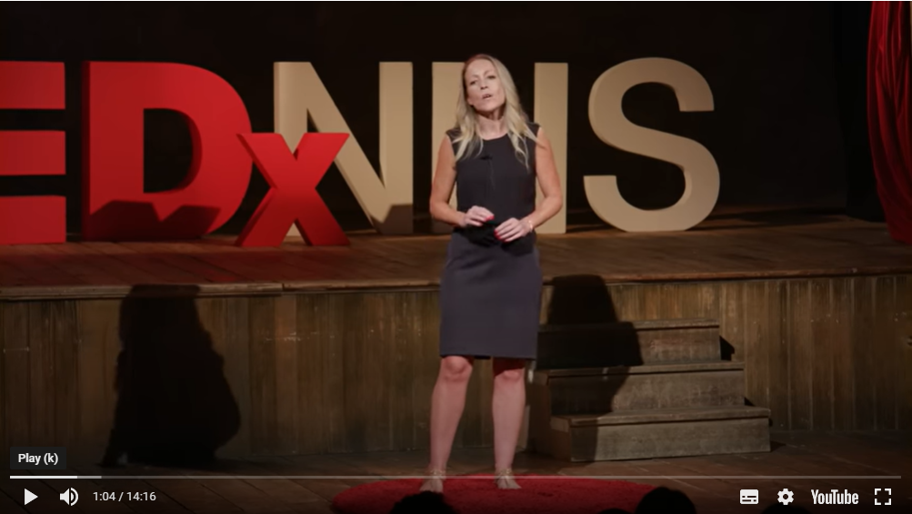
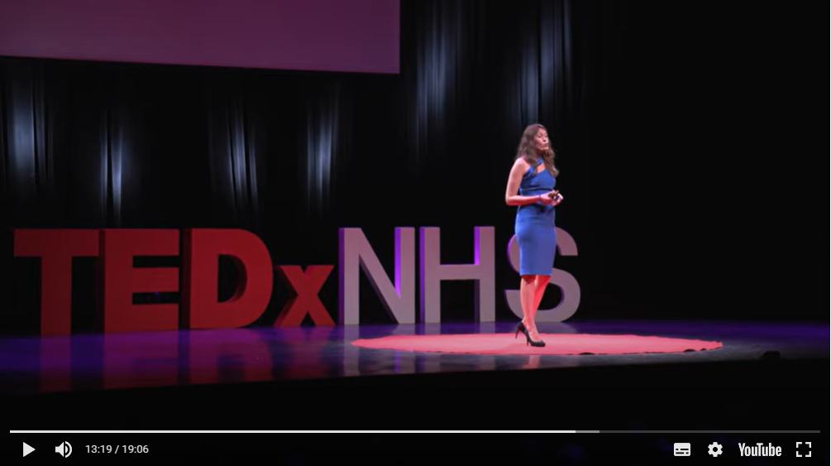
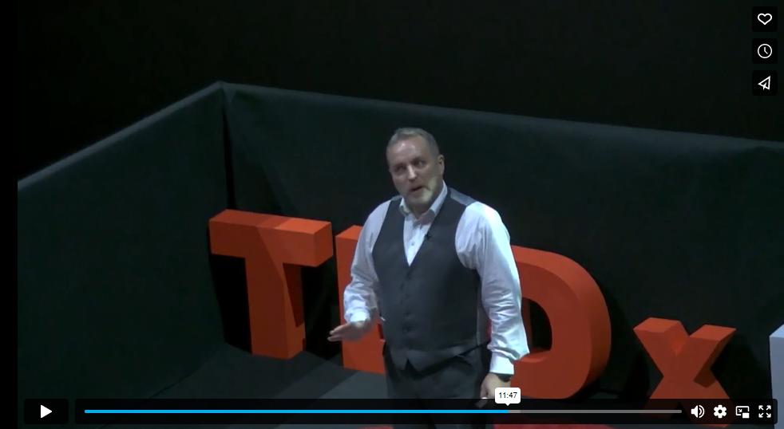
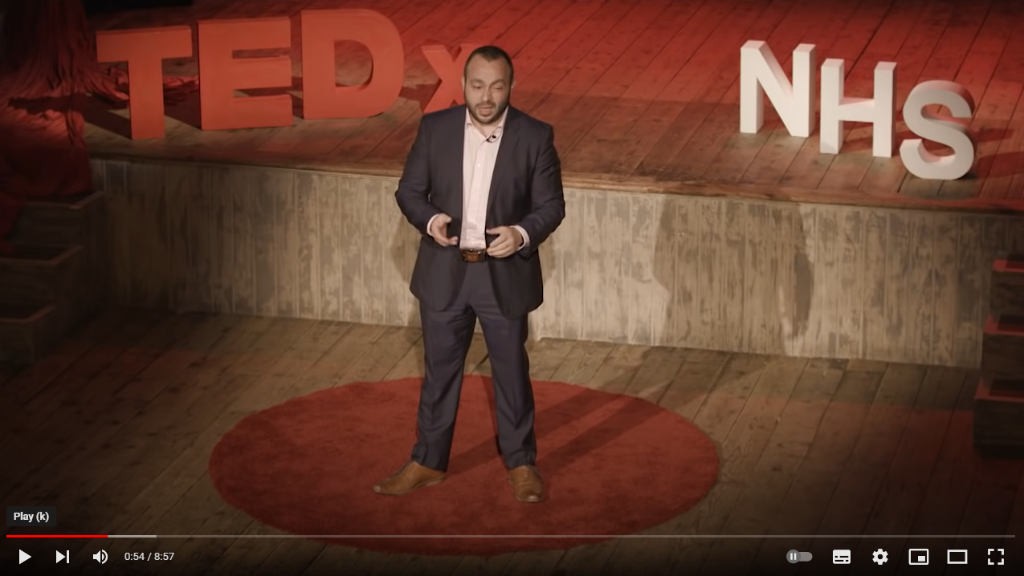
Examples of TEDxNHS talks
2022 – Hannah Kirkbride – The cliff edge of care
2019 – Kate Morrissey – Do we truly believe in rehabilitation?
2018 – Chris Turner – Civility saves lives
2017 – Simon Flemming – The era of the bully is over

Slide 8
Any questions?

